Slide 1
WEB Technologies (CS-566)
LECTURE # 9– Forms in HTML

Slide 2
Outline
HTML FORMS
FORM Attributes
HTML FORM Elements/Tags with their Attributes

Slide 3
HTML Forms

Slide 4
Creating HTML Forms
HTML Forms are required, when you want to collect some data from the site visitor. For example, during user registration you would like to collect information such as name, email address, credit card, etc.
Forms provide a means of submitting information from client to the server.
HTML supports tags for creating forms, however, it does not process the information.
Use server-side script to process form information such as CGI, ASP Script or PHP script etc.
Server-side script runs on Web server and receives data from a form and uses it to perform a set of tasks.

Slide 5
Cont…
<form> </form> tag is used to start and end a form.
Between <form> and </form>, form elements/tags are placed.
We can declare a form as:
<form attributes>
form elements and layout tags
</form>
A single page can include several different forms, but you cannot nest one form inside another.

Slide 6
Forms Attributes

Slide 7
Form Attributes
Value | Description
action | Specifies where to send the form-data when a form is submitted. <form action="/action_page.php"> </form> If the action attribute is omitted, the action is set to the current page.
target | Specifies where to display the response that is received after submitting the form. <form action="/action_page.php" target="_blank"> </form> _self(default), _parent, _top, framename, _blank
method | Specifies the HTTP method to use when sending form-data (GET/POST). <form action="/action_page.php" method="get"> </form> <form action="/action_page.php" method="post"> </form>

Slide 8
Cont…
Values | Description
name | Specifies the name of the form. <form action="/action_page.php" name=“Form”> </form>
autocomplete | Specifies whether a form should have autocomplete on or off. <form action="/action_page.php" autocomplete="on"> </form>
novalidate | Specifies that the form should not be validated when submitted. <form action="/action_page.php" novalidate> </form>

Slide 9
Form Elements/Tags
Along with their Attributes

Slide 10
Form Elements/tags
INPUT
LABEL
SELECT
TEXTAREA
FIELDSET
LEGEND

Slide 11
Input element/control/Tag

Slide 12
Input
<INPUT>
The <input> element can be displayed in several ways, depending on the type attribute.
Attributes:
TYPE
Indicates the type of input control that which type of input is to taken.
<input type="button"> <input type="checkbox"> <input type="color"> <input type="date">
<input type="datetime-local"> <input type="email"> <input type="file"> <input type="hidden"> <input type="image"> <input type="number"> <input type="password"> <input type="radio"> <input type="range"> <input type="reset"> <input type="search"> <input type="submit"> <input type="tel"> <input type="text"> <input type="time"> <input type="url">
<input type="text">(Default)
NAME
The name attribute is used to reference elements in a JavaScript, or to reference form data after a form is submitted. If the name attribute is omitted, the value of the input field will not be sent at all.
<input type="text" name="fname">
SIZE
The input size attribute specifies the visible width, in characters, of an input field. The default value for size is 20. It works with these input types: text, search, URL, telephone, email, and password.
<input type="text" id="fname" name="fname" size="50">

Slide 13
Cont…
VALUE
It specifies an initial value for an input field. It may vary according to different type of input.
<input type="text" name="fname" value="John"><br>
Maxlength
The input maxlength attribute specifies the maximum number of characters allowed in an input field.
<input type="text“ name="pin" maxlength="4" size="4>
Min & Max
The input min and max attributes specify the minimum and maximum values for an input field. These are work with the following input types: number, range, date, datetime-local, month, time and week.
<input type="date’’ name="datemax" max=“2000-12-31">
<input type="date" name="datemin" min=“1979-12-31">

Slide 14
Cont…
ReadOnly
The input readonly attribute specifies that an input field is read-only. A read-only input field cannot be modified (however, a user can tab to it, highlight it, and copy the text from it). The value of a read-only input field will be sent when submitting the form!
<input type="text" name="fname" value="John“ Readonly><br>
Multiple
The input multiple attribute specifies that the user is allowed to enter more than one value in an input field. The multiple attribute works with the following input types: email, and file.
<input type="file" name="files" multiple>
Placeholder
The input placeholder attribute specifies a short hint that describes the expected value of an input field (a sample value or a short description of the expected format). The short hint is displayed in the input field before the user enters a value. The placeholder attribute works with the following input types: text, search, url, tel, email, and password.
<input type=“number" name="phone" placeholder="123-45-678“>

Slide 15
Cont…
Required
The input required attribute specifies that an input field must be filled out before submitting the form. The required attribute works with the following input types: text, search, url, tel, email, password, date pickers, number, checkbox, radio, and file.
<input type="text" name="username" required>
Height & Width
The input height and width attributes specify the height and width of an <input type="image">
<input type="image" src="img_submit.gif" alt="Submit" width="48" height="48">
Disabled
The input disabled attribute specifies that an input field should be disabled. A disabled input field is unusable and un-clickable. The value of a disabled input field will not be sent when submitting the form!
<input type="text" name="fname" value="John“ disabled>

Slide 16
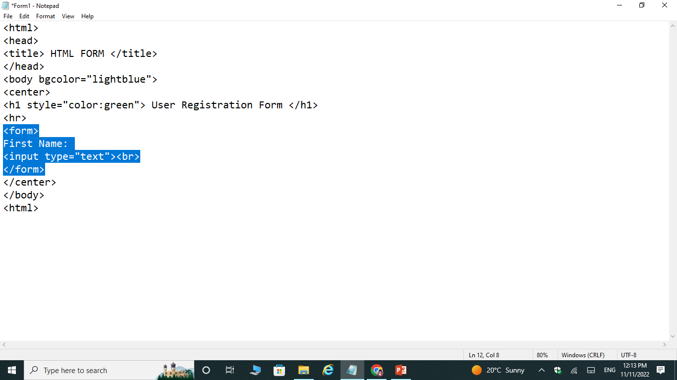
Example

Slide 17
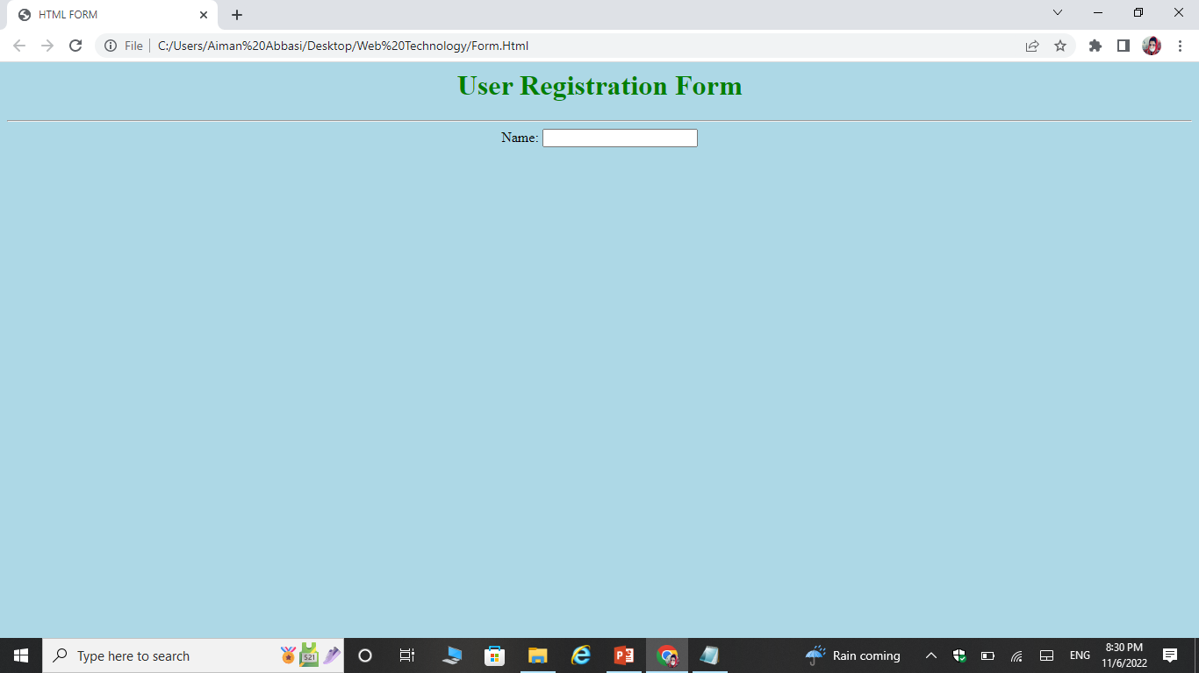
Output

Slide 18
Input Type Text
Defines a single-line input field for text input.
Syntax:
<INPUT TYPE=“TEXT”>
Attributes:
Name
Size
Value
Maxlength
Readonly
Disabled
Placeholder
Required

Slide 19
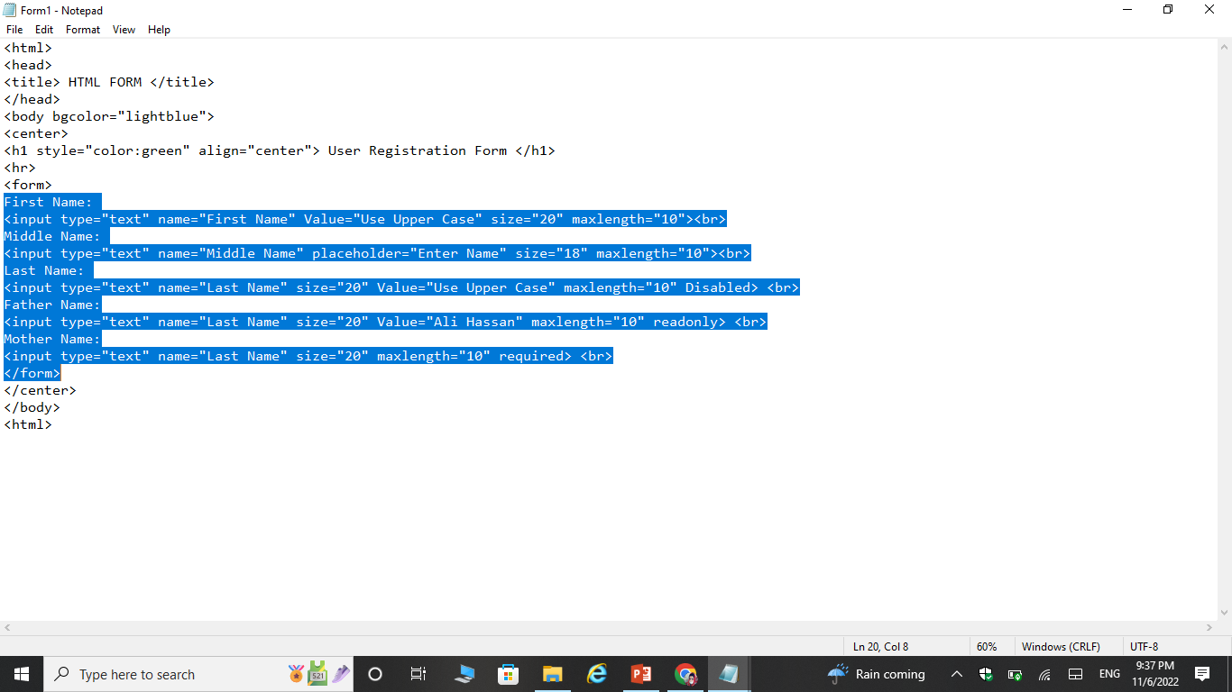
Example

Slide 20
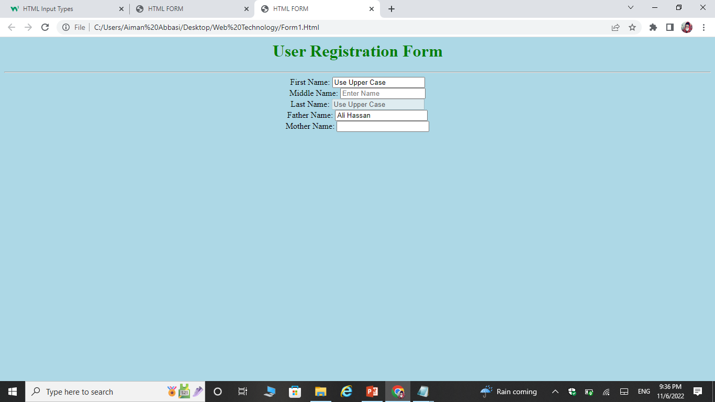
Output

Slide 21
Input Type Password
Defines a password field.
<INPUT TYPE=“PASSWORD”>
Name
Size
Value
Maxlength
Required
Placeholder

Slide 22
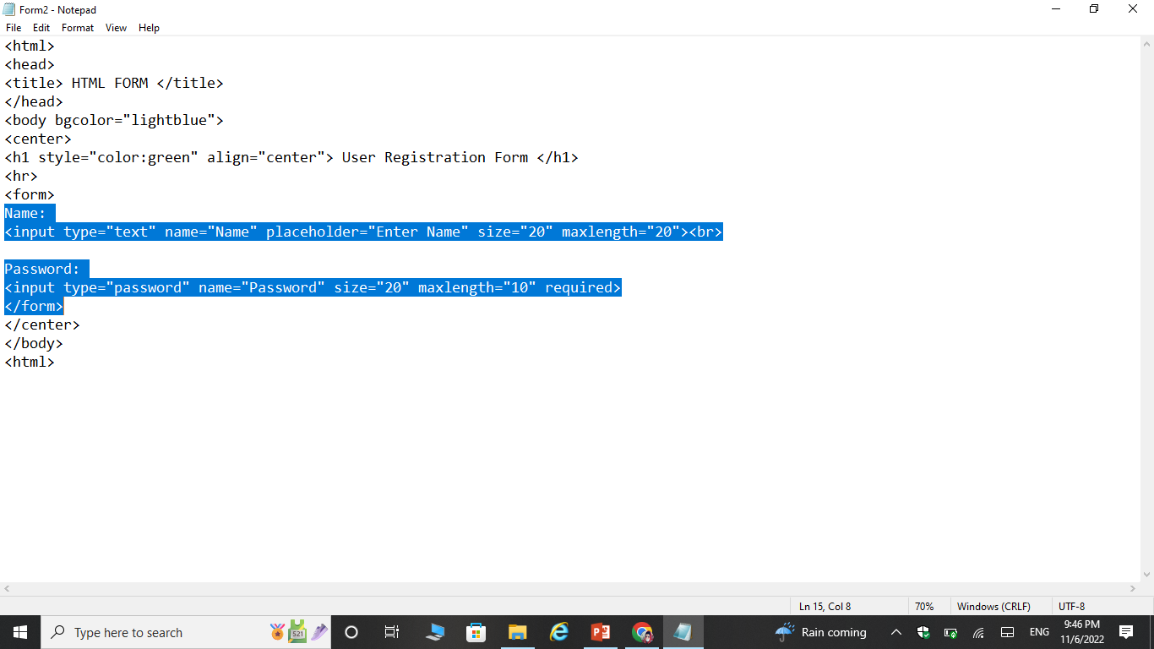
Example

Slide 23
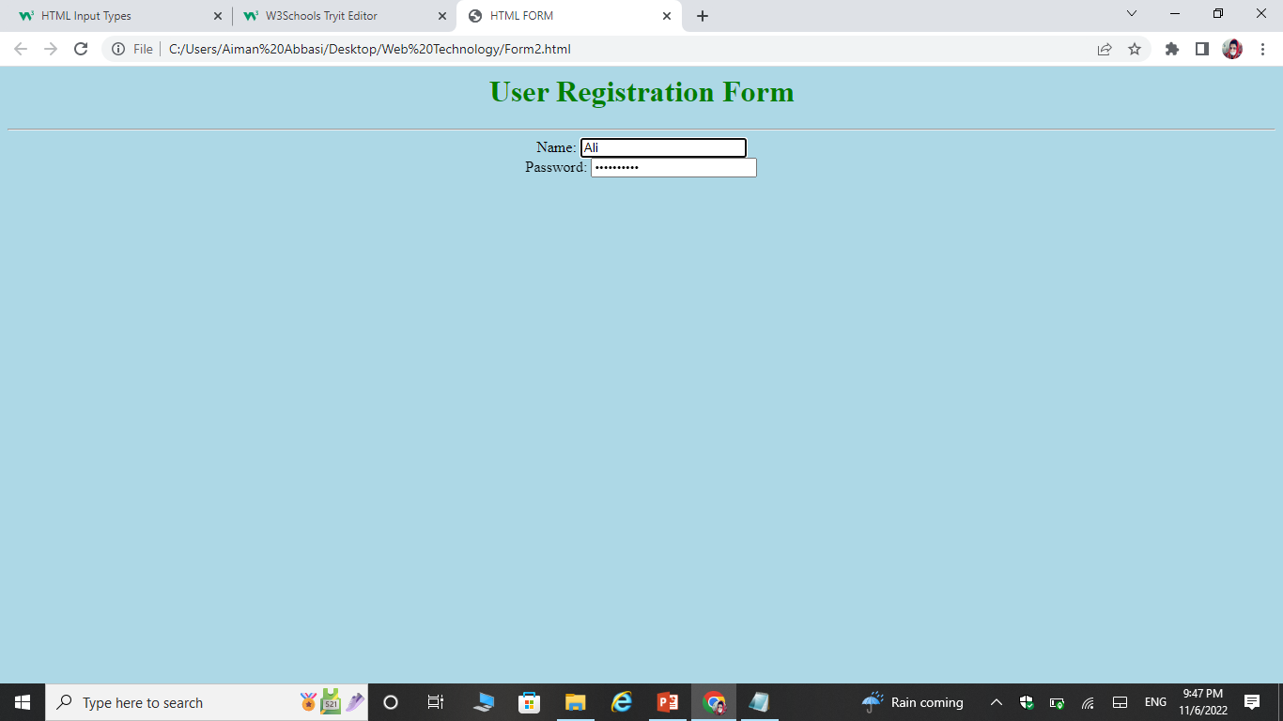
Output

Slide 24
Input Type Hidden
Defines a hidden input field (not visible to a user).
<INPUT TYPE=“HIDDEN”>
Name
Size
Value
Maxlength
Required
These fields provide a means for servers to store state information with a form.
This will be pass back to server when form is submitted, using name/value pair defined by corresponding attributes.

Slide 25
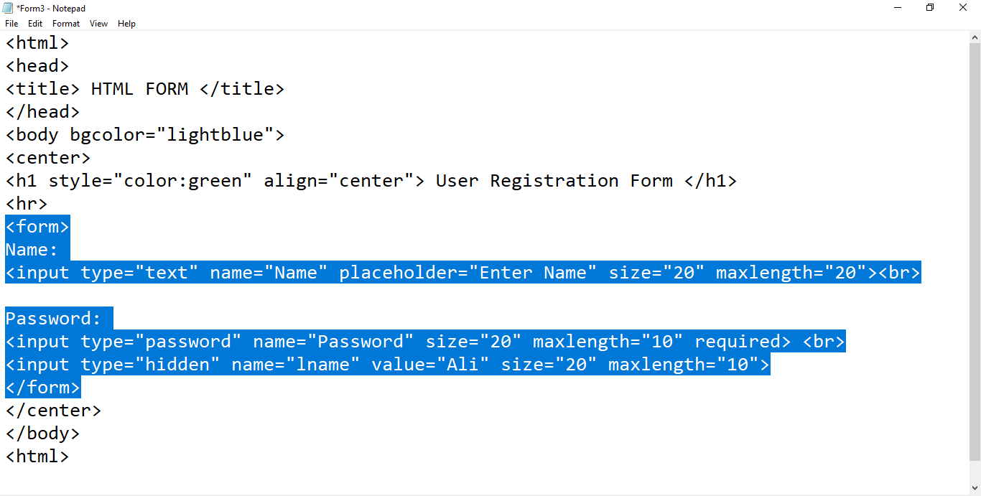
Example

Slide 26
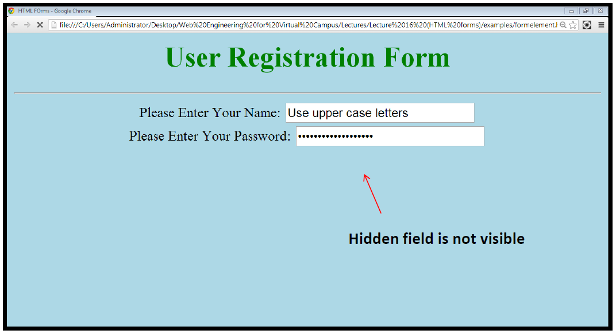
Output

Slide 27
Checkbox
Checkboxes let a user select ZERO or MORE options of a limited number of choices.
<INPUT TYPE=“CHECKBOX”>
Checked
Name
Value

Slide 28
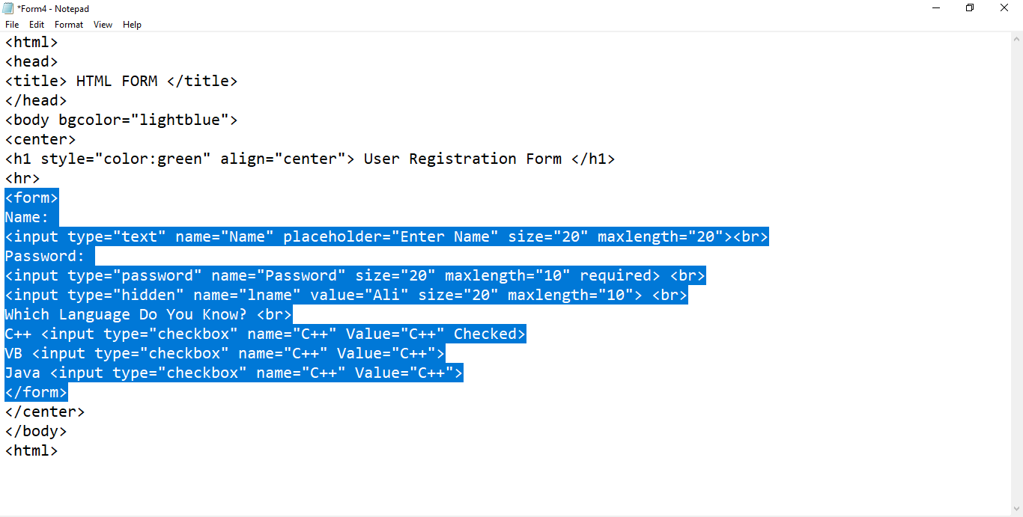
Example

Slide 29
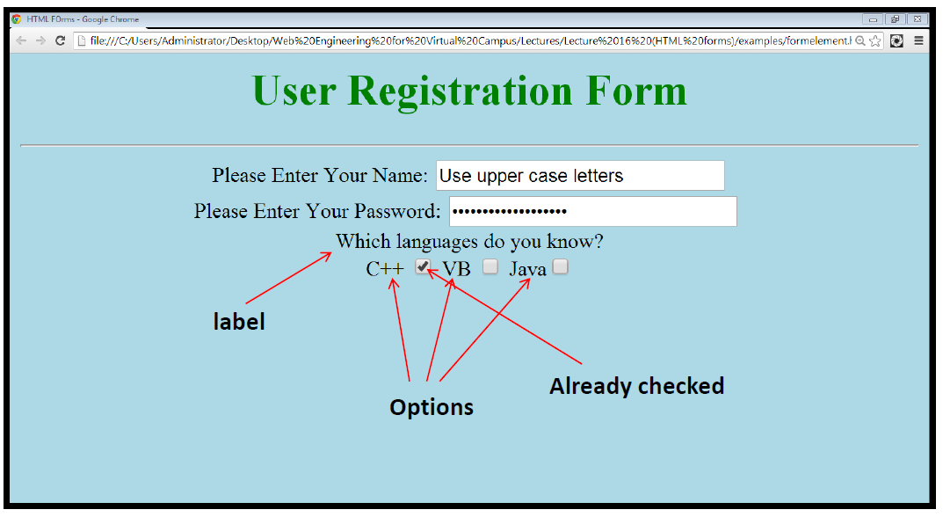
Output

Slide 30
Input type Radio
Radio buttons let a user select ONLY ONE of a limited number of choices.
<INPUT TYPE=“RADIO”>
CHECKED
NAME
VALUE

Slide 31
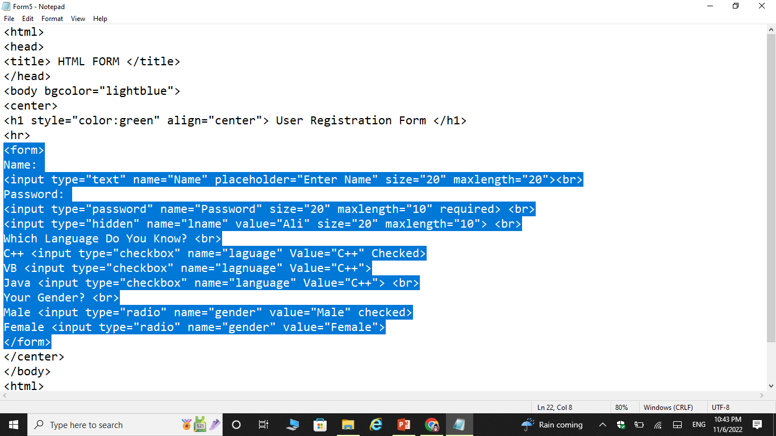
example

Slide 32
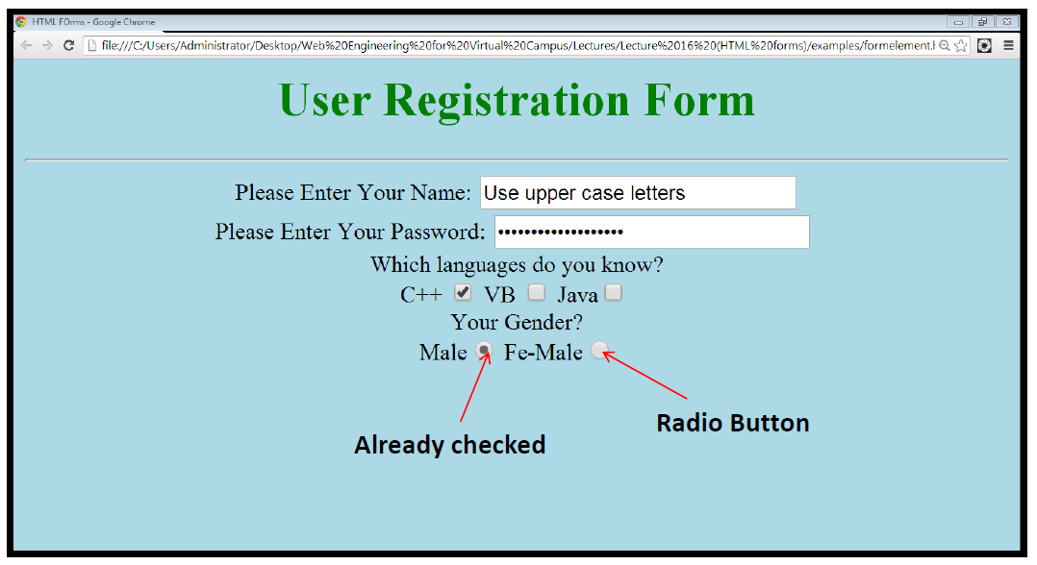
Example

Slide 33
Input Type Email
It is used for input fields that should contain an e-mail address.
<INPUT TYPE=“EMAIL”>
Name
Value
Placeholder
Required
Multiple(Separated by coma)

Slide 34
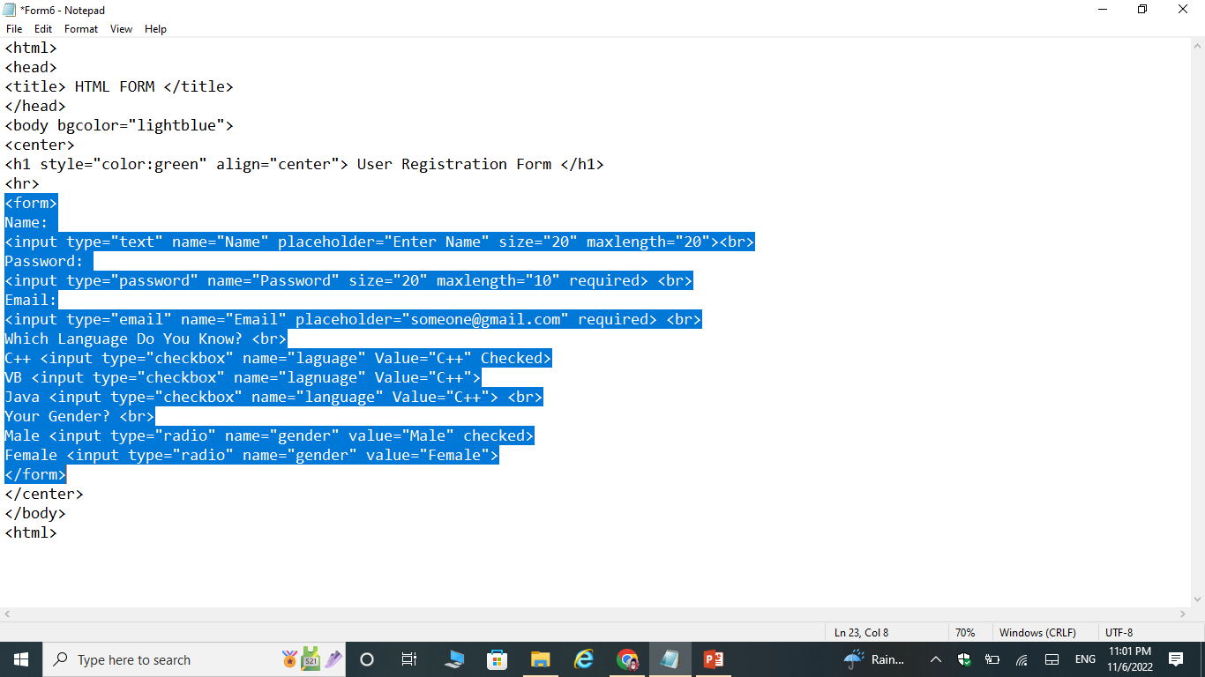
Example

Slide 35
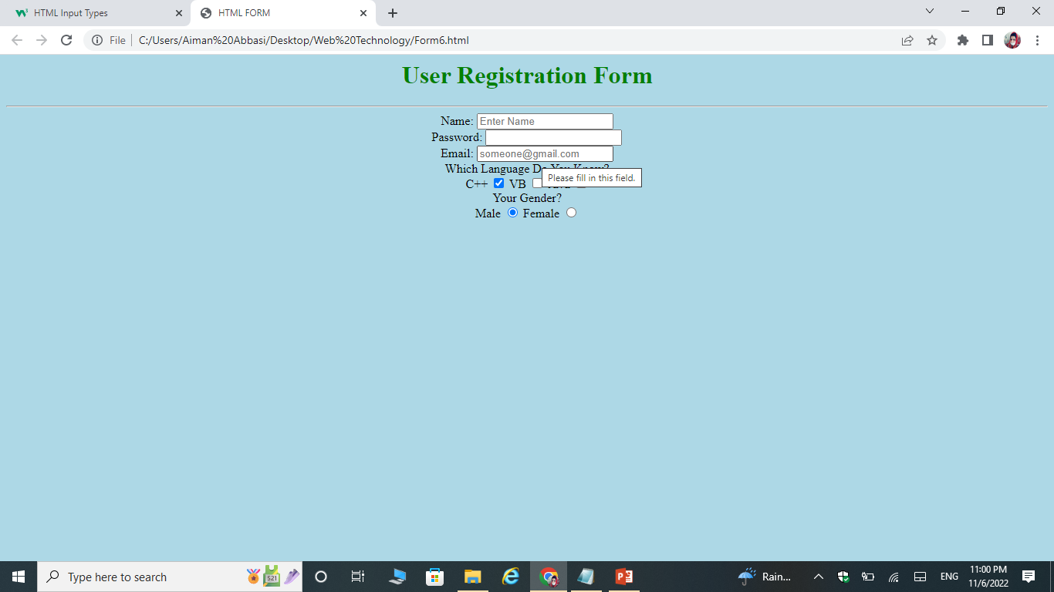
Output

Slide 36
Input Type Color
It is used for input fields that should contain a color.
<INPUT TYPE=“COLOR”>
Name

Slide 37
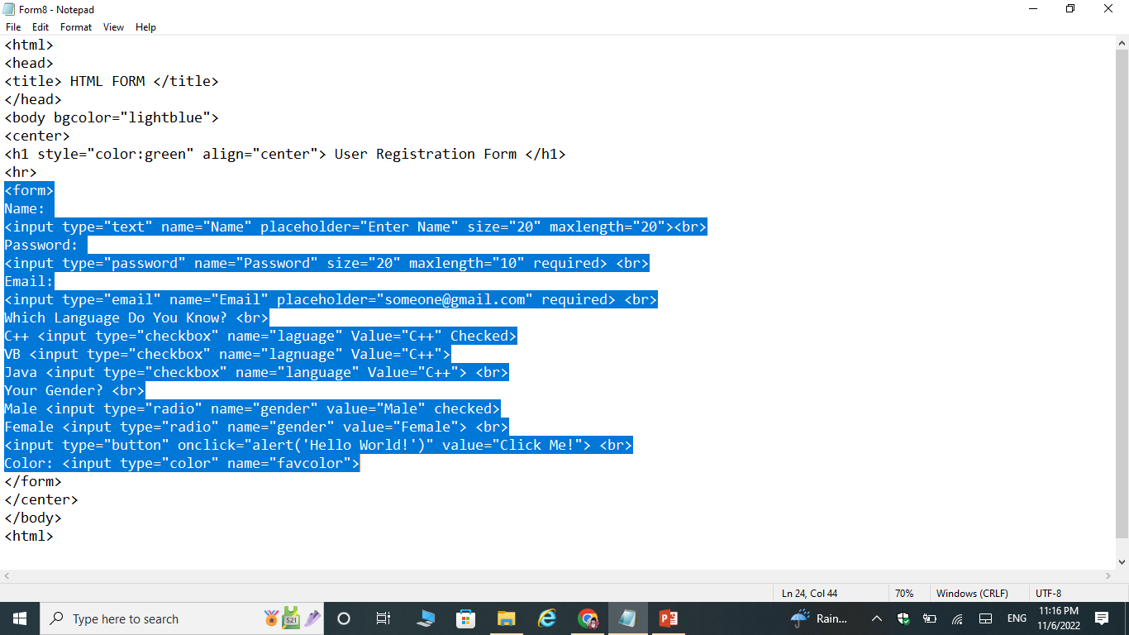
Example

Slide 38
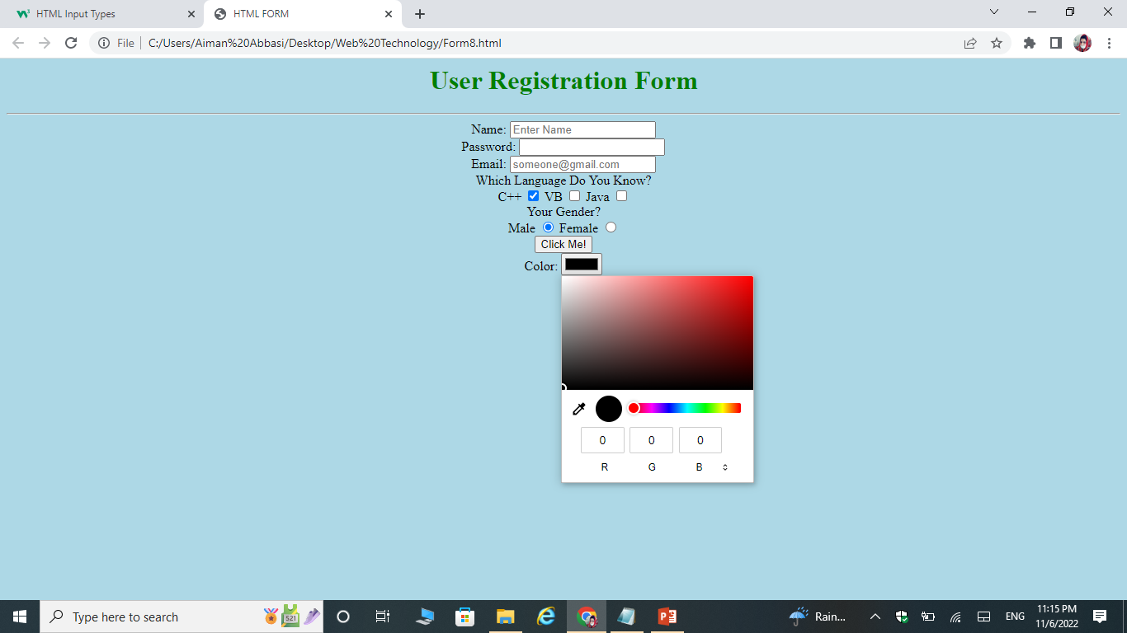
Output Type

Slide 39
Input Type Date
It is used for input fields that should contain a date.
<INPUT TYPE=“DATE”>
Name
Min
Max
INPUT TYPE TIME
It is used for input fields that should contain a date.
<INPUT TYPE=“TIME”>
Name

Slide 40
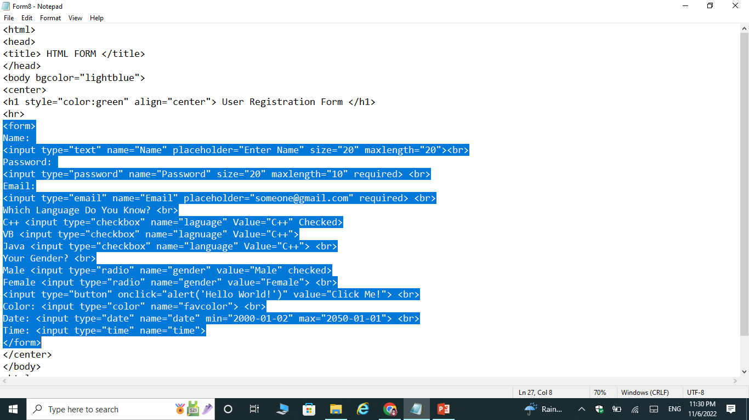
Example

Slide 41
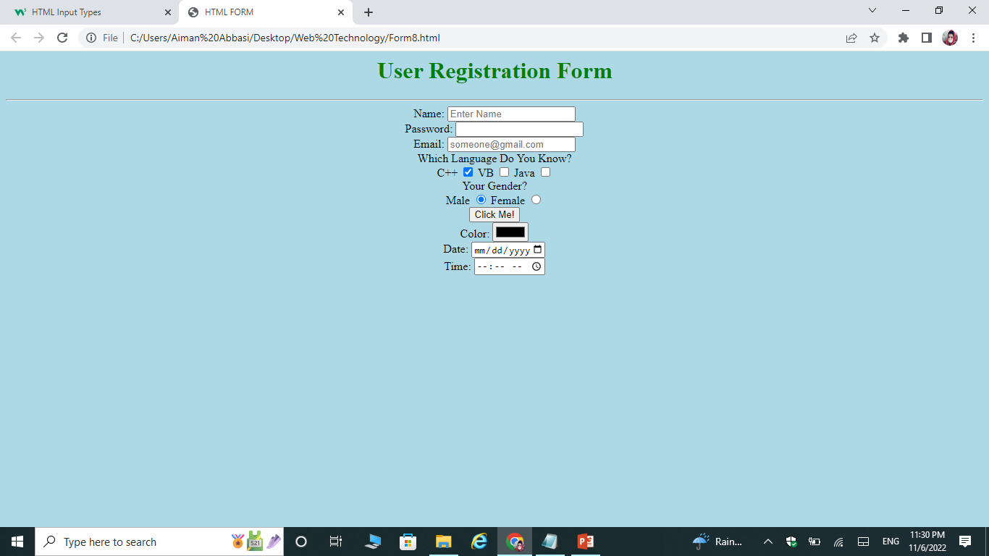
Output

Slide 42
Input Type Datetime-Local
It specifies a date and time input field, with no time zone.
<INPUT TYPE=“DATETIME-LOCAL”>
Name

Slide 43
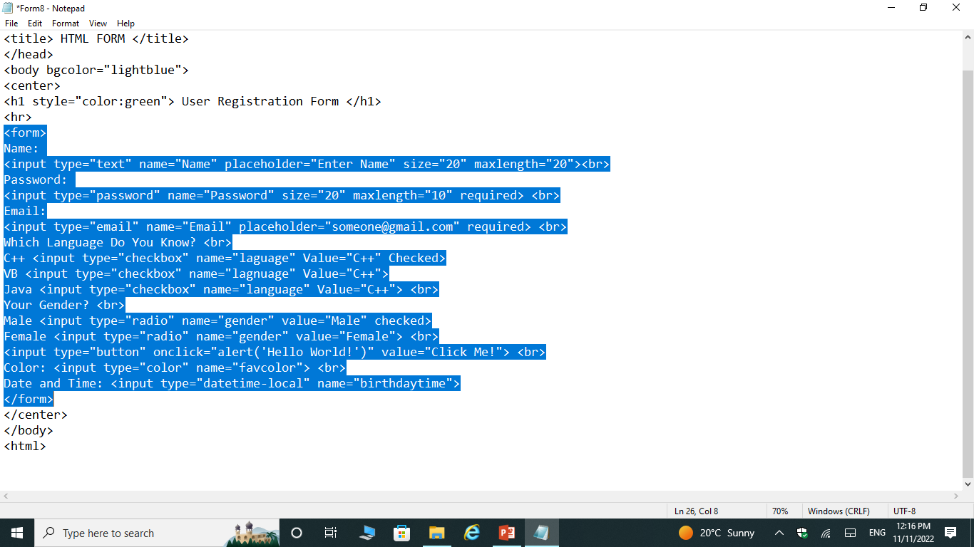
example

Slide 44

Output

Slide 45
Input type range
It specifies a range of data.
<INPUT TYPE=“RANGE”>
Name
Min
Max

Slide 46
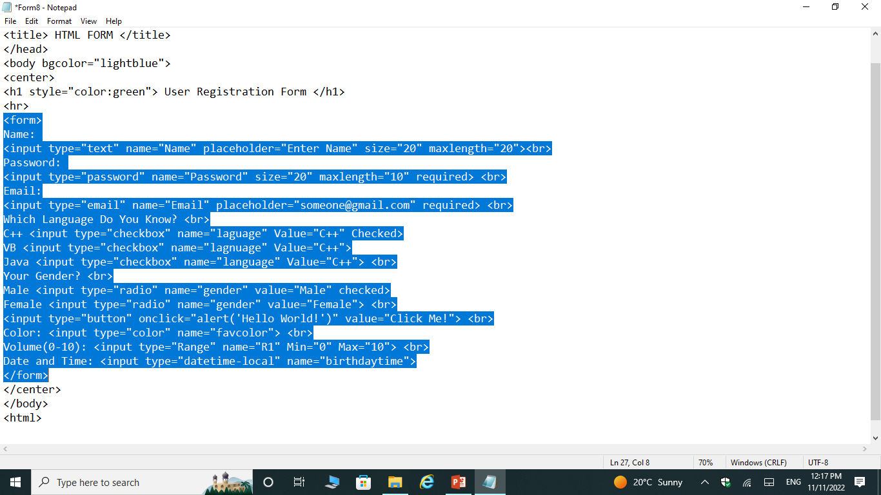
example

Slide 47
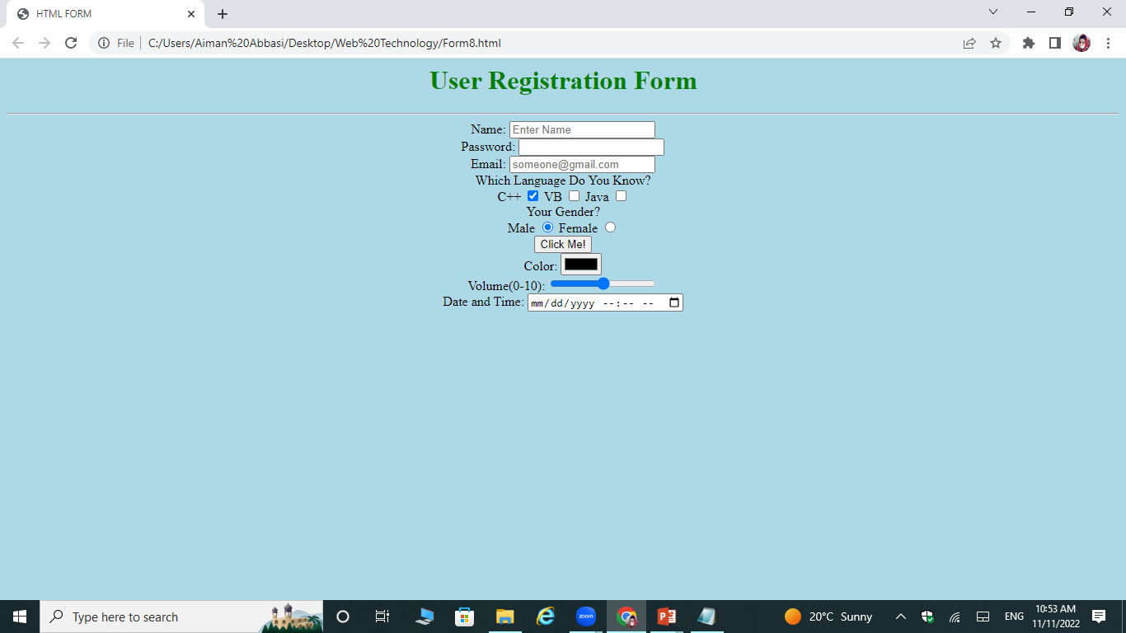
output

Slide 48
Input Type FilE
Defines a file-select field and a "Browse" button for file uploads.
<INPUT TYPE=“FILE”>
Name
Multiple

Slide 49

Example

Slide 50
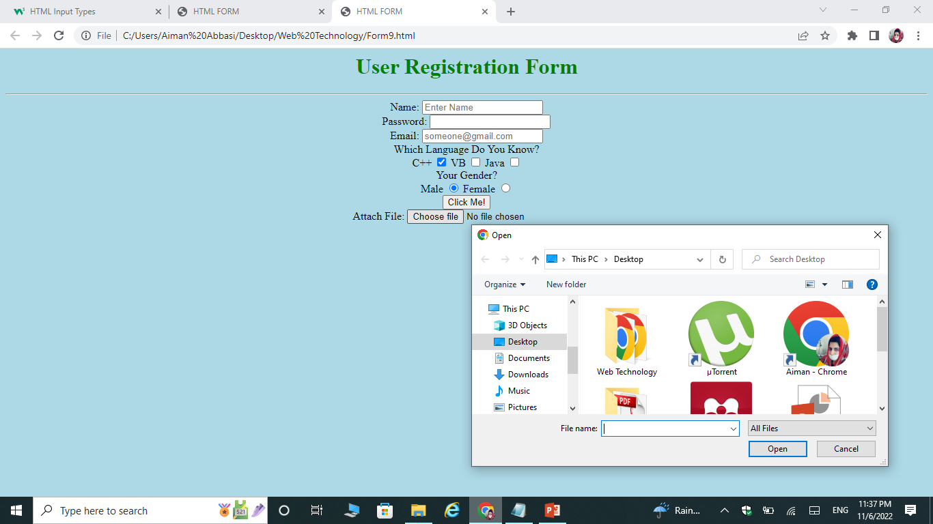
Output

Slide 51
Input Type ButtoN
Defines a button.
<INPUT TYPE=“BUTTON”>
Name
Value
Onclick
Autofocus
Disabled

Slide 52
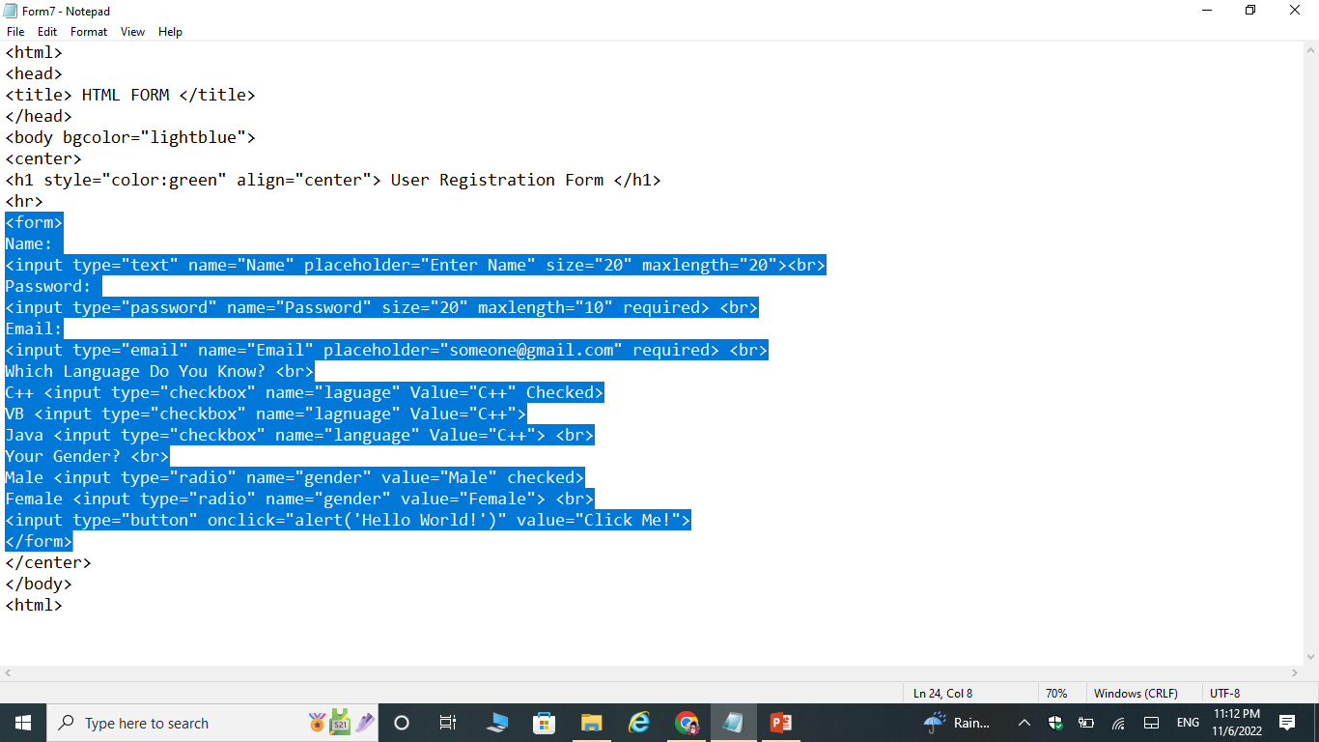
Example

Slide 53
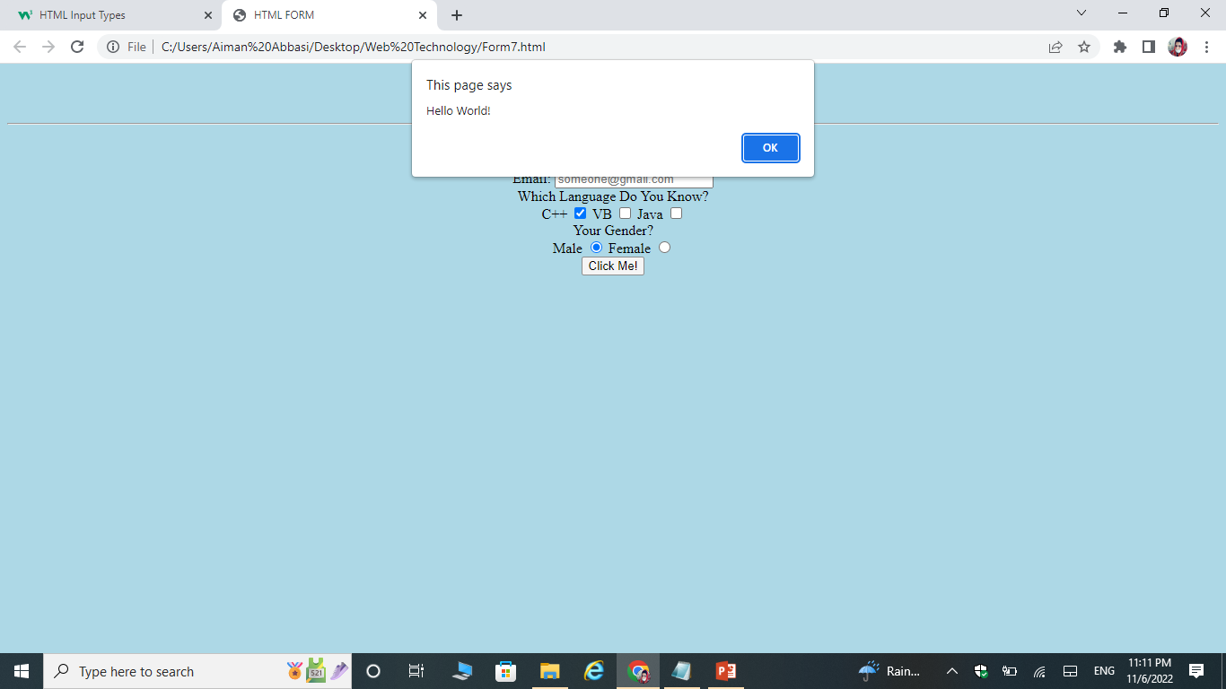
Output

Slide 54
Input Type Submit Button
Defines a button for submitting form data to a form-handler.
The form-handler is typically a server page with a script for processing input data.
<INPUT TYPE=“SUBMIT”>
Value
formonvalidate
formtarget
INPUT TYPE RESET BUTTON
Defines a reset button that will reset all form values to their default values:
<INPUT TYPE=“RESET”>
Value

Slide 55
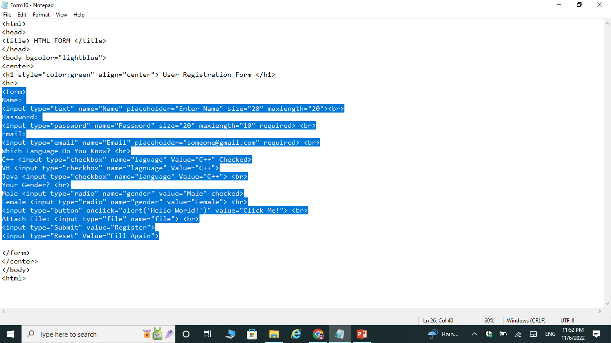
Example

Slide 56
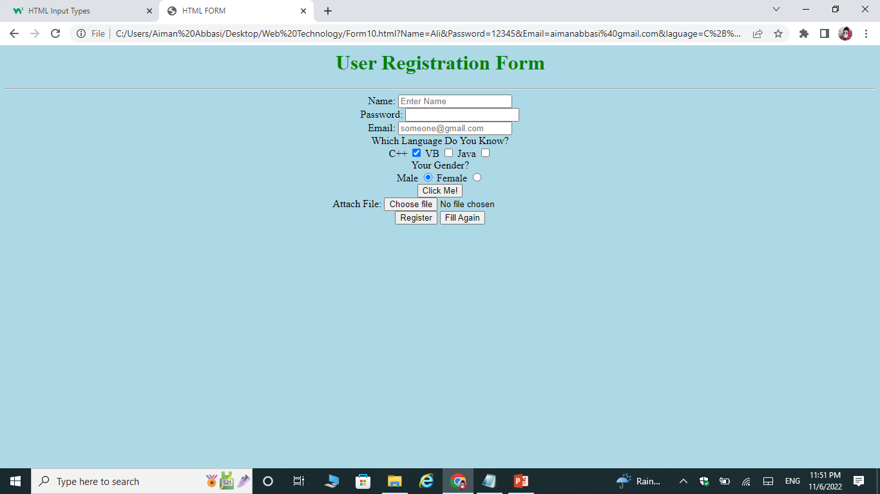
Output

Slide 57
Input Type Number
Defines a numeric input field. You can also set restrictions on what numbers are accepted.
<INPUT TYPE=“NUMBER”>
Value
Name
Min
Max

Slide 58
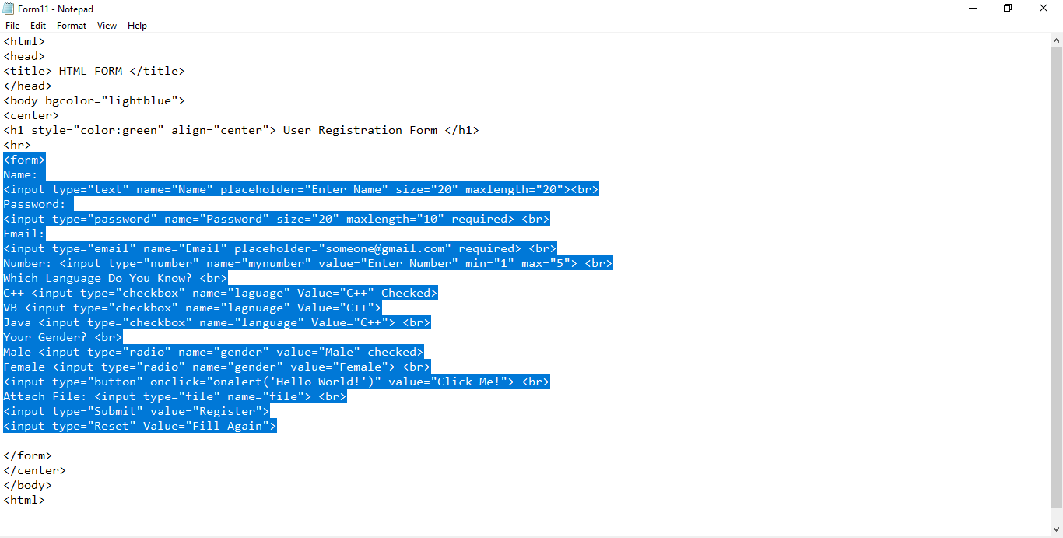
Example

Slide 59
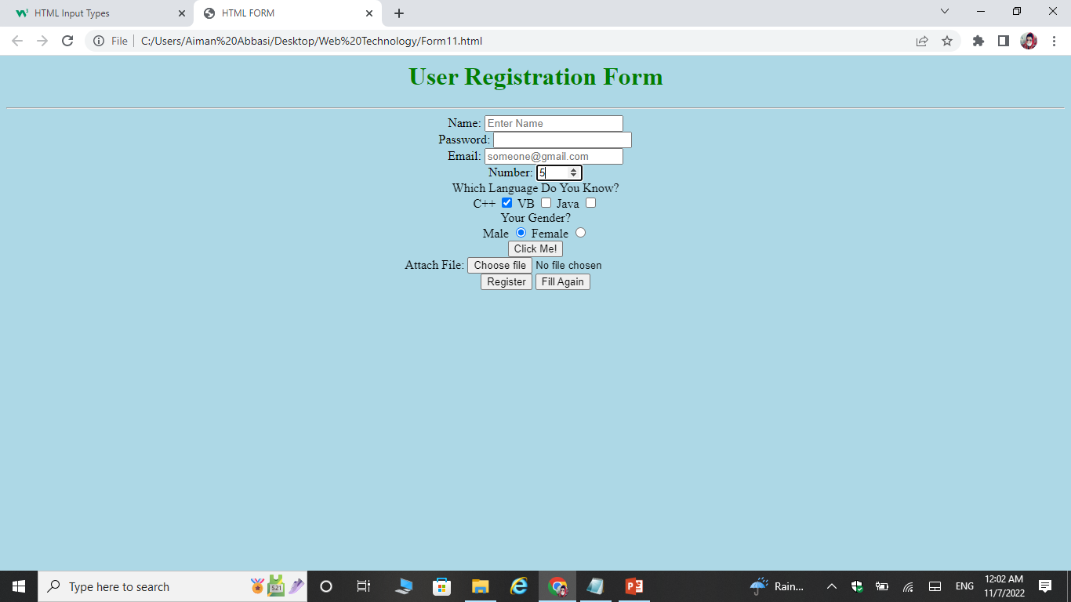
Output

Slide 60
Input Type image
Defines an image as a submit button.
<INPUT TYPE=“IMAGE”>
src
Name
Alt
Width
Height

Slide 61
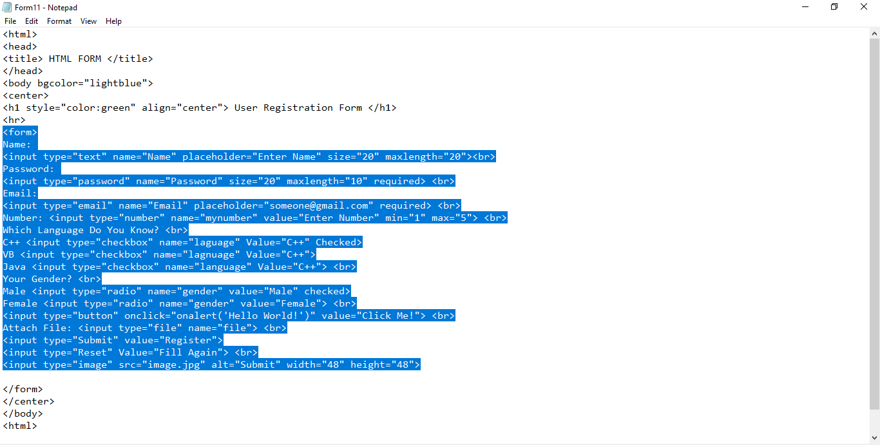
Example

Slide 62
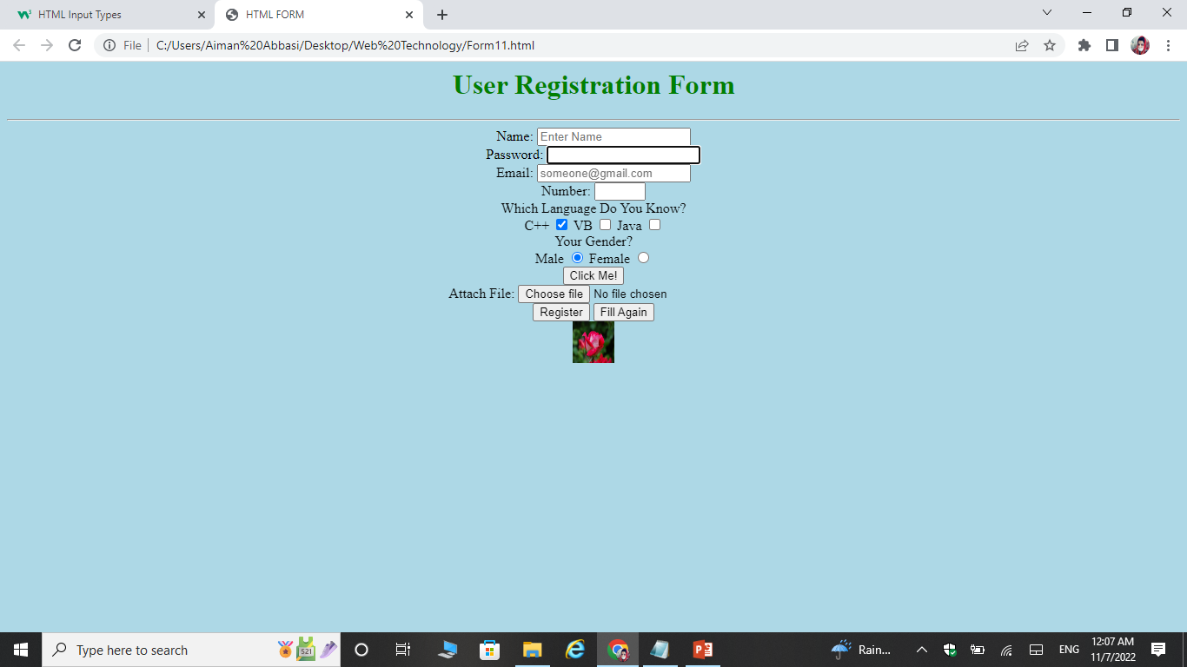
Output

Slide 63
Input Type Tel
It is used to take the phone number.
<INPUT TYPE=“TEL”>
Name
Value
Placeholder
Required
Size
Maxlength

Slide 64
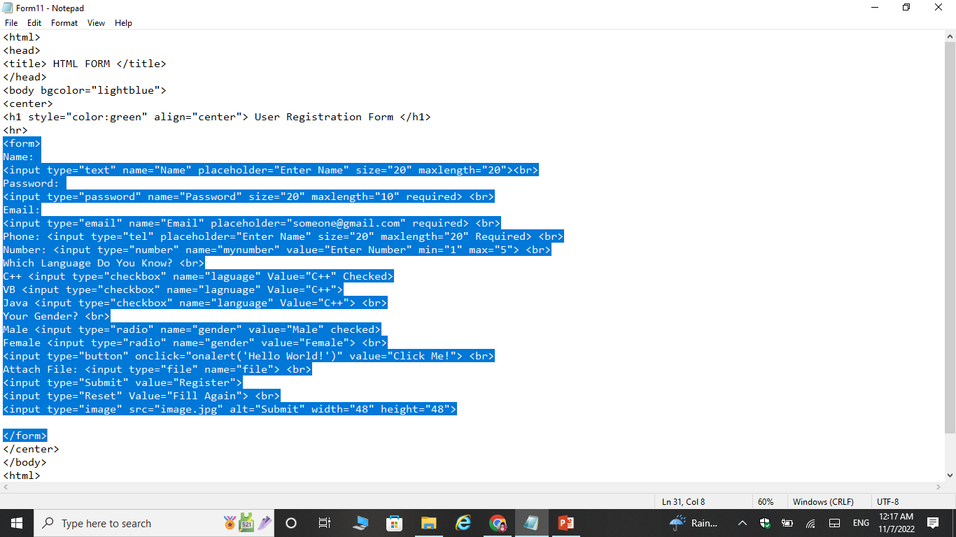
Example

Slide 65
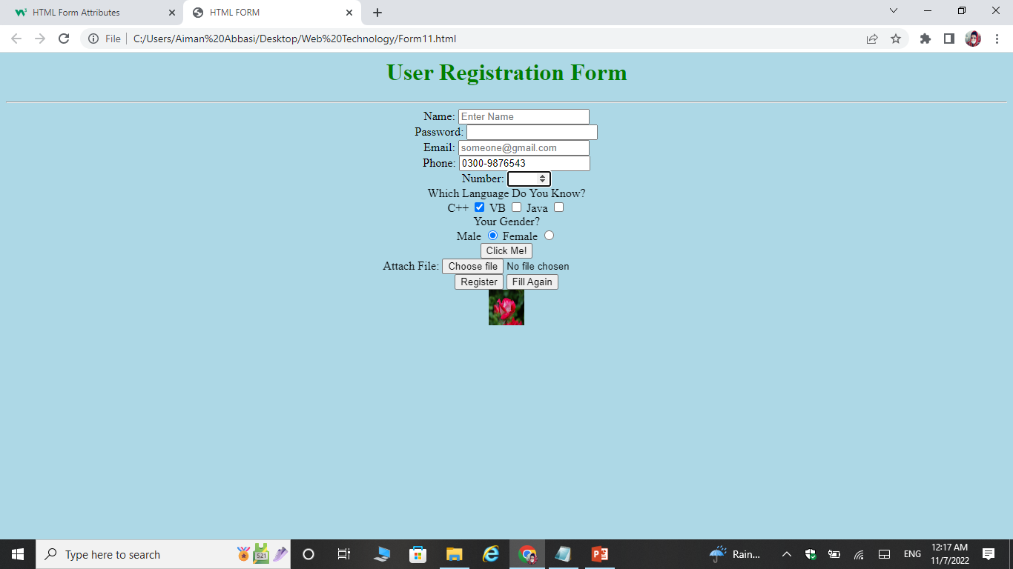
Output

Slide 66
Input type URL
It is used to take URL address as input.
<INPUT TYPE=“URL”>
Name
Value
Placeholder
Required

Slide 67
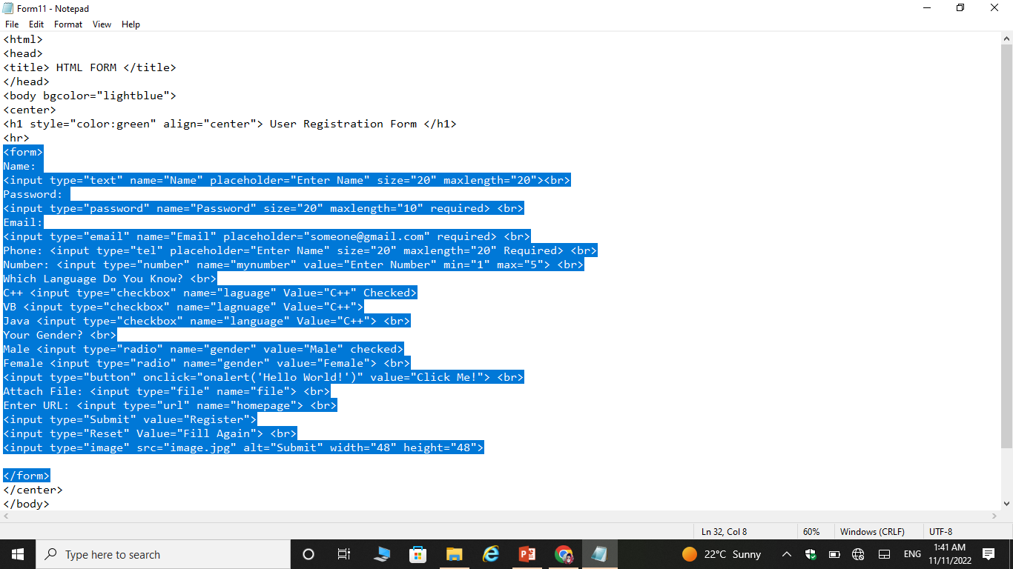
Example

Slide 68
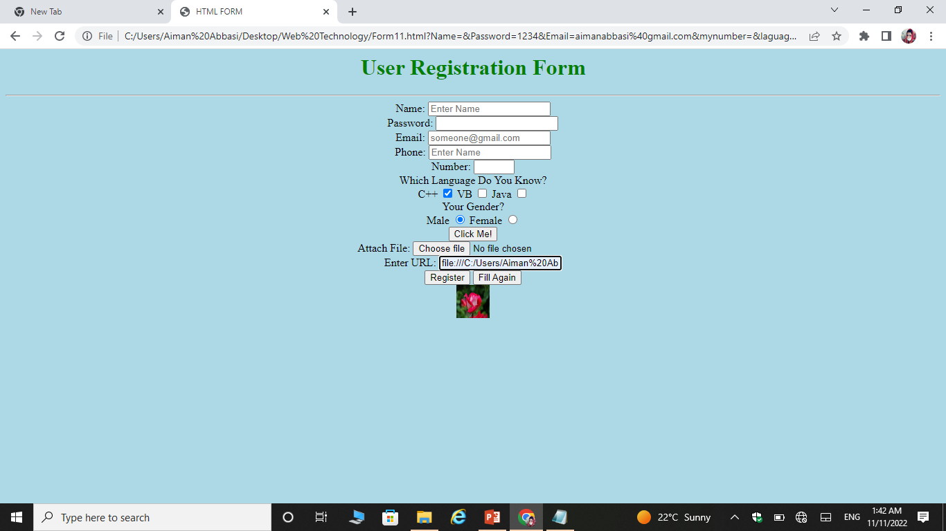
output

Slide 69
Input Type Search bar
Defines for entering search strings.
<INPUT TYPE=“Search”>
Name
Value
Placeholder
Required

Slide 70
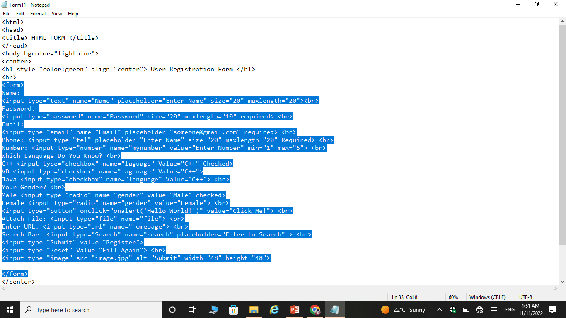
example

Slide 71
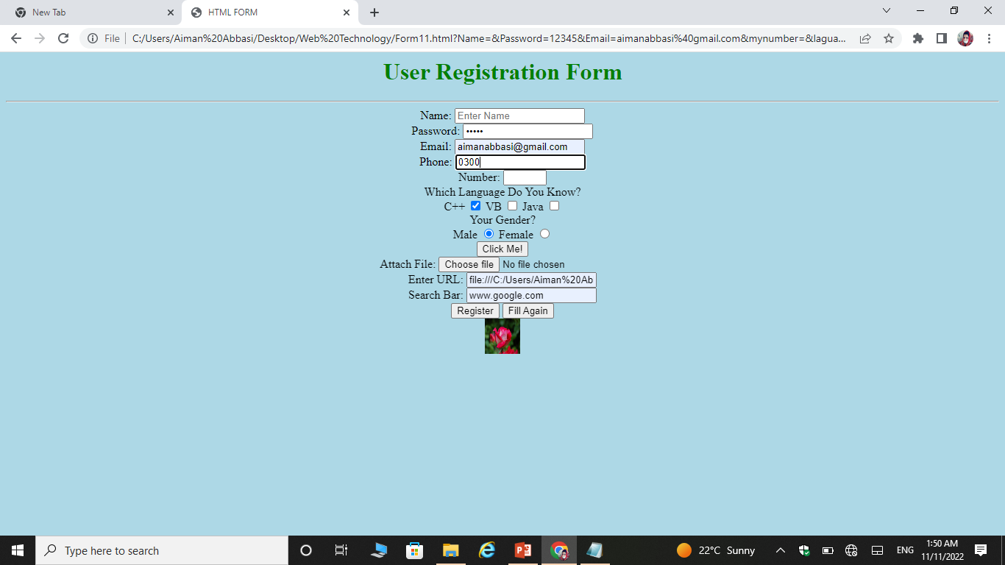
output

Slide 72
List Attribute
The input list attribute refers to a <datalist> element that contains pre-defined options for an <input> element.
Syntax:
<input list=“name”>
<datalist id=“name”> <option value=“option1”> </datalist>
The list attribute of the <input> element, must refer to the id attribute of the <datalist> element.

Slide 73
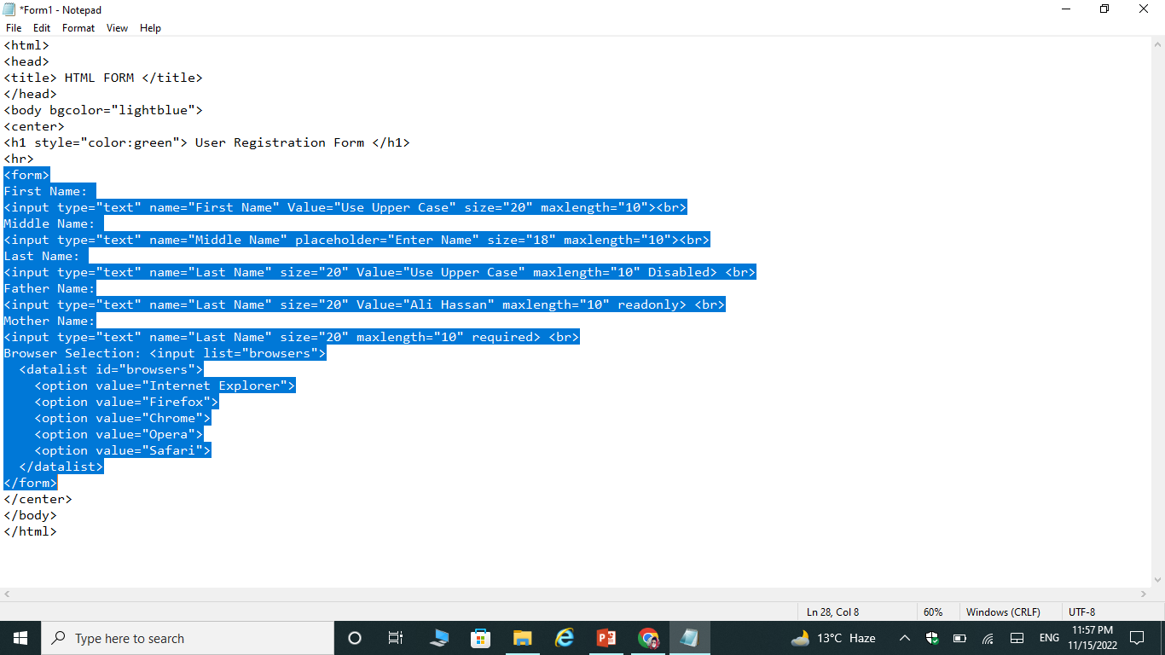
Example

Slide 74
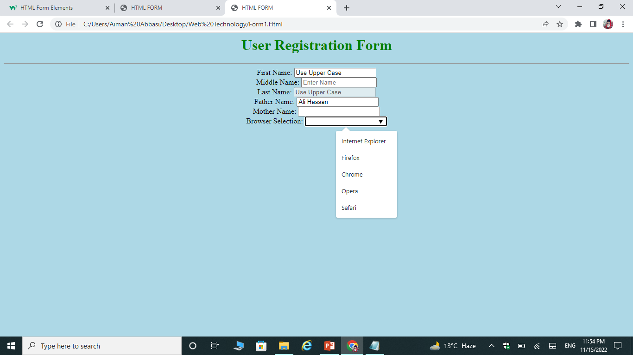

Slide 75
Label element/control/Tag

Slide 76
Label
It defines the label for form elements/tags.
Syntax:
<label> </label>
It is useful for screen-reader users, because the screen-reader will read out loud the label when the user focus on the input element.
Attributes:
For
For input elements/tags use id attribute to bind it with for attribute of label.

Slide 77
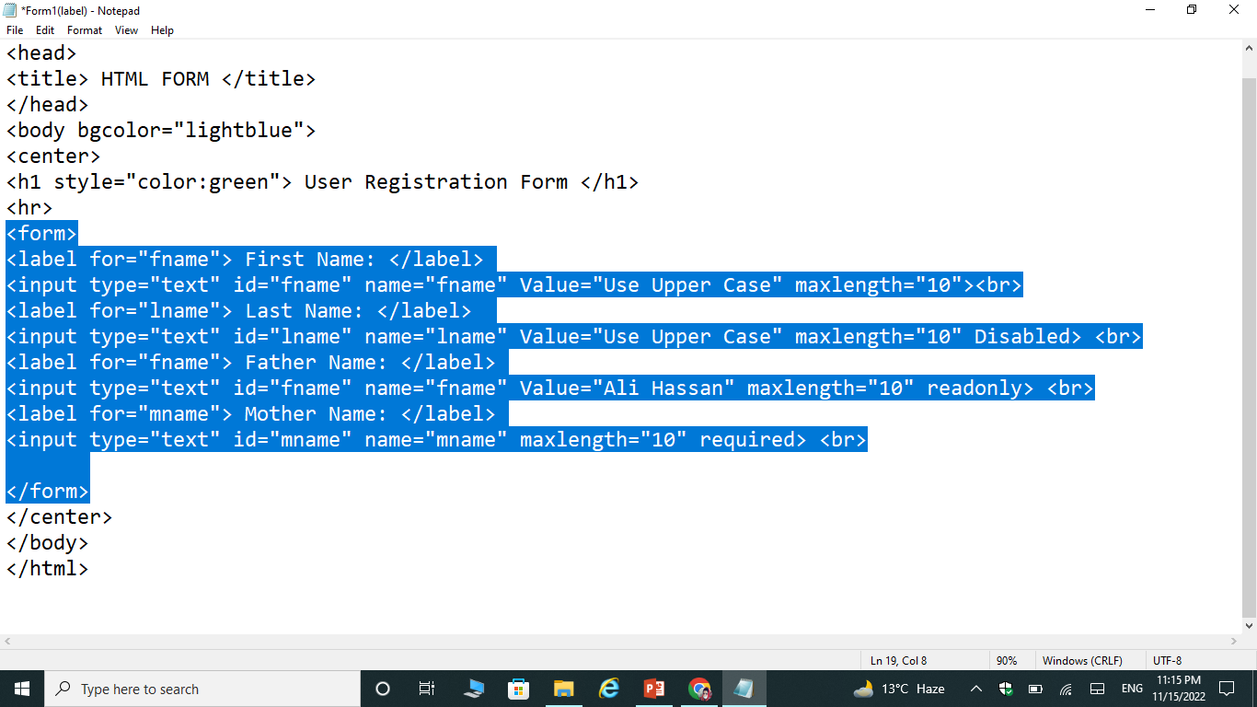
Example

Slide 78

Output

Slide 79
Select & Option element/control/Tag

Slide 80
Select and Option
It defines the drop-down list.
Syntax:
<select> </select>
Attributes:
Name
Size
Multiple
OPTION
It defines an option that can be selected. By default, the first item in the drop-down list is selected.
Syntax:
<option> </option>
Attributes:
Value
Selected

Slide 81
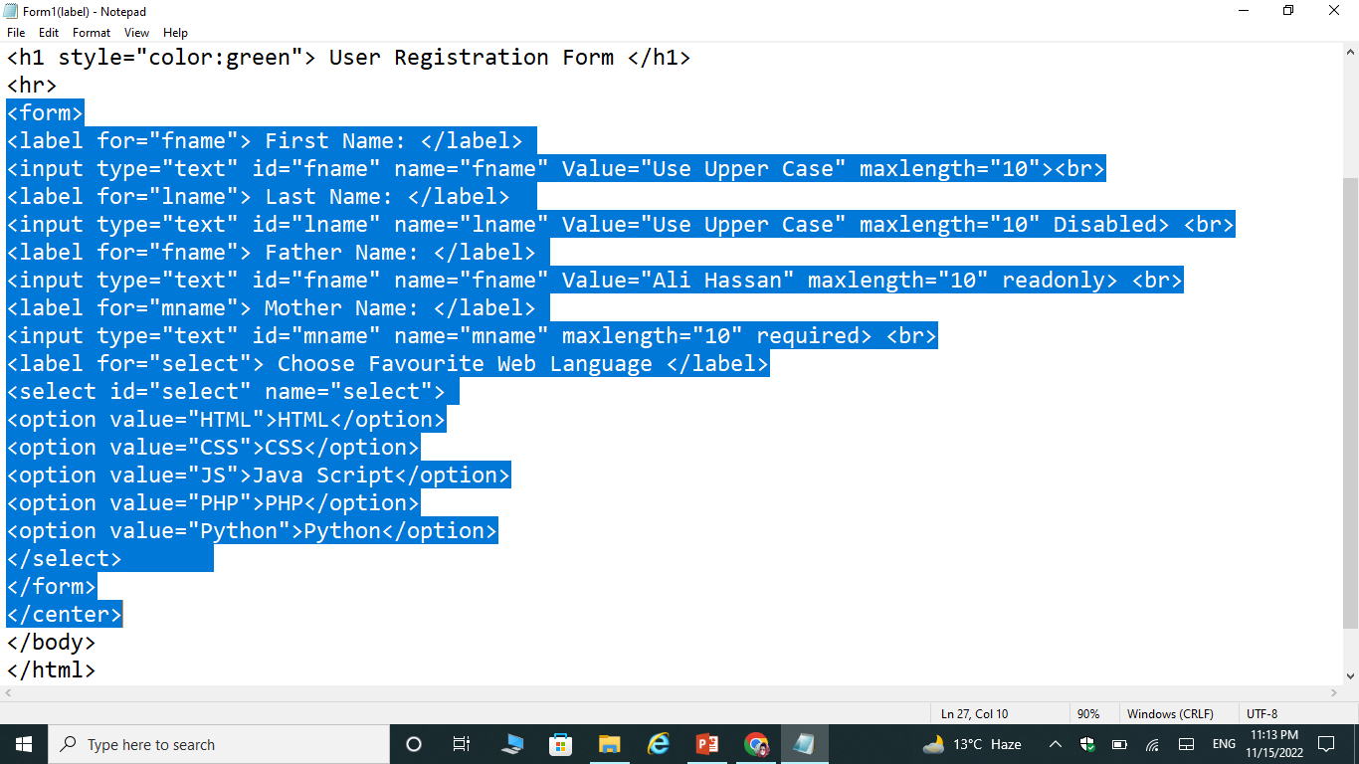
Example

Slide 82
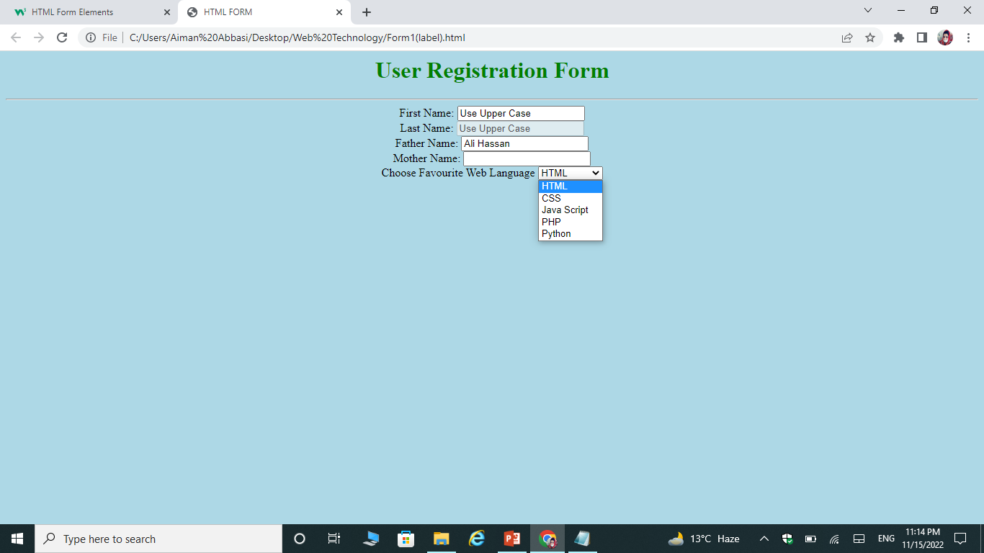
Output

Slide 83
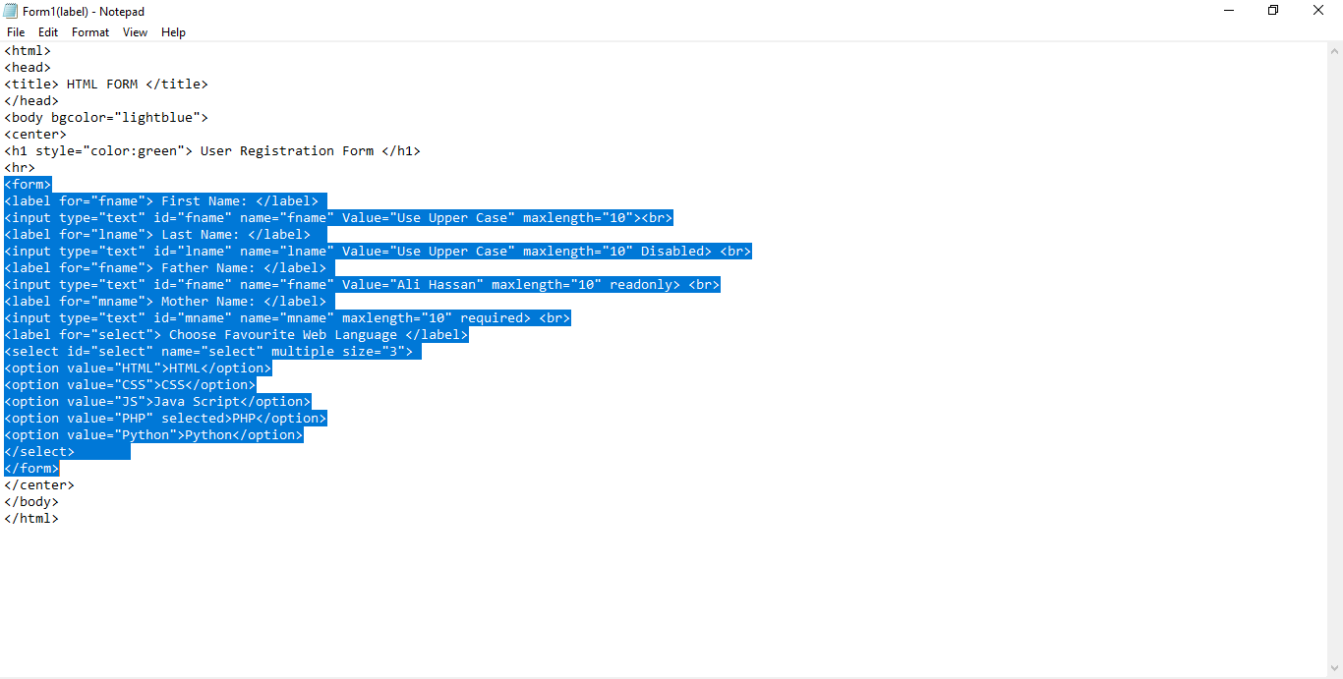
output

Slide 84
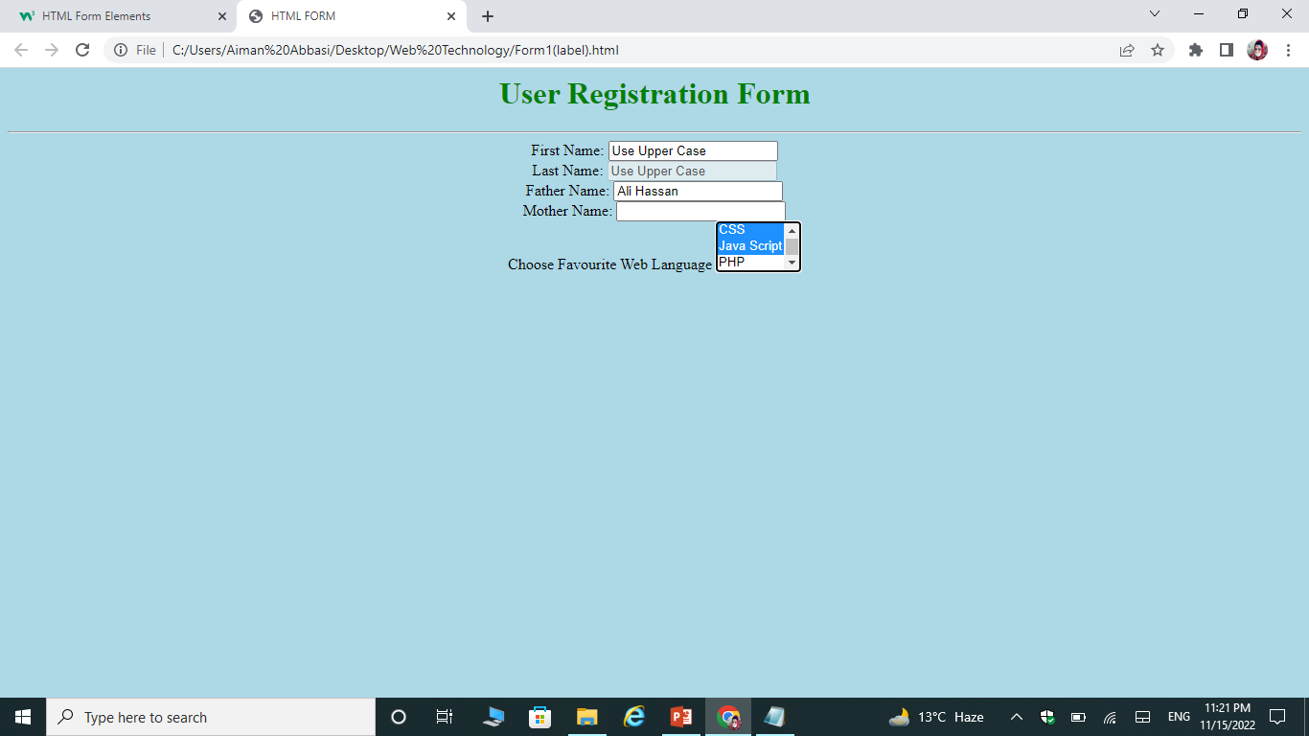
example

Slide 85
Textarea element/control/tag

Slide 86
TextArea
It defines a multi-line input field.
Syntax:
<textarea> </textarea>
Attributes:
Name
Rows or width
Specifies the visible number of line in text area.
Cols or Height
Specifies the visible width of text area.

Slide 87
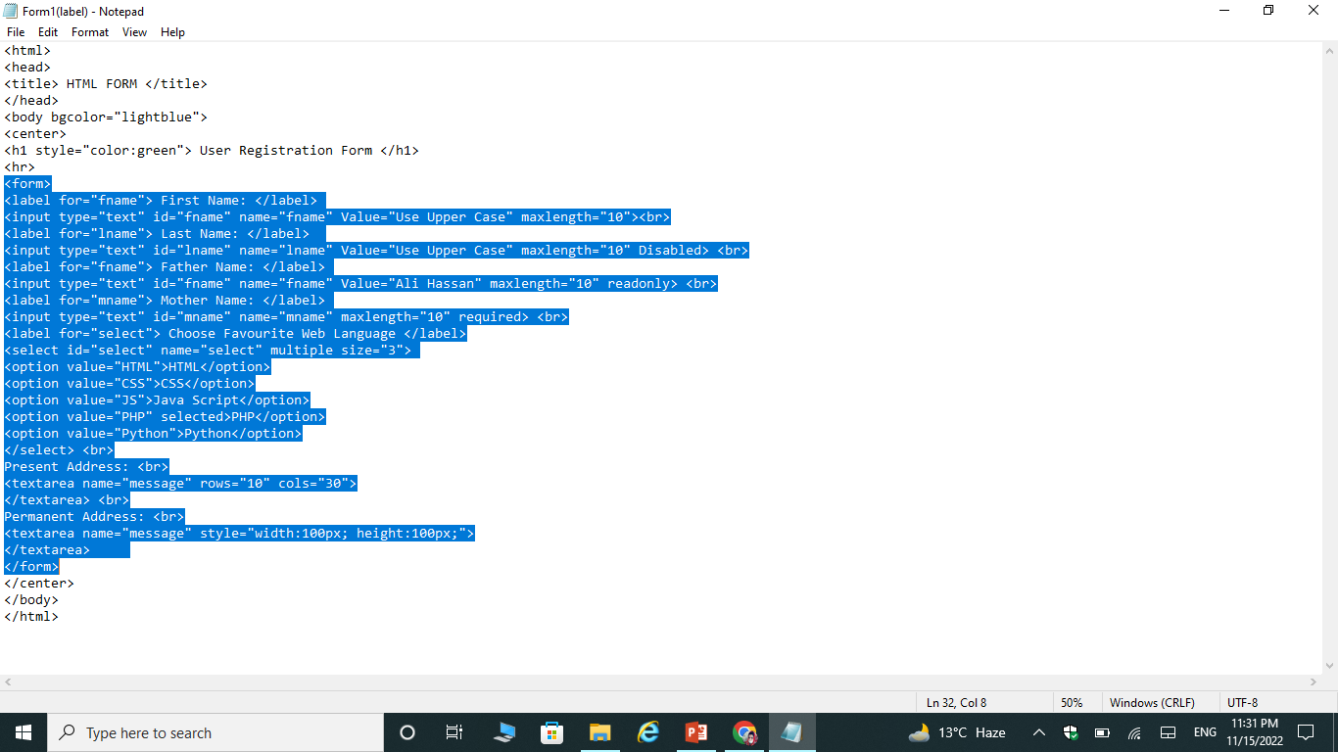
Example

Slide 88
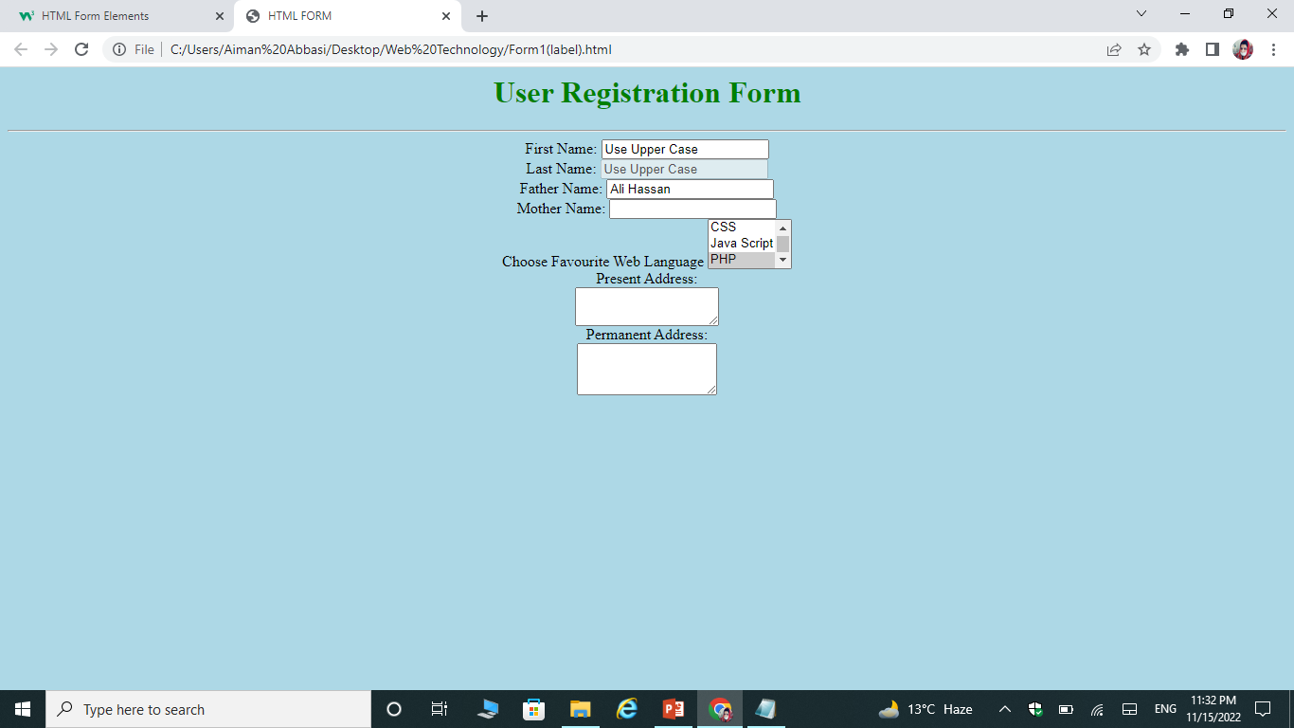
Output

Slide 89
Fieldset & legend element/control/tag

Slide 90
Fieldset & legend
FIELDSET
It is used to group related data in a form.
Syntax:
<fieldset> </fieldset>
LEGEND
It defines a caption for the <fieldset> element.
Syntax:
<legend> </legend>

Slide 91
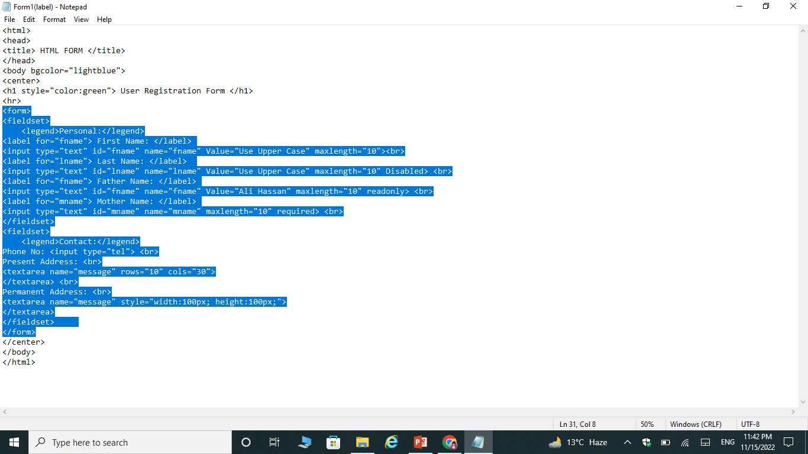
example

Slide 92
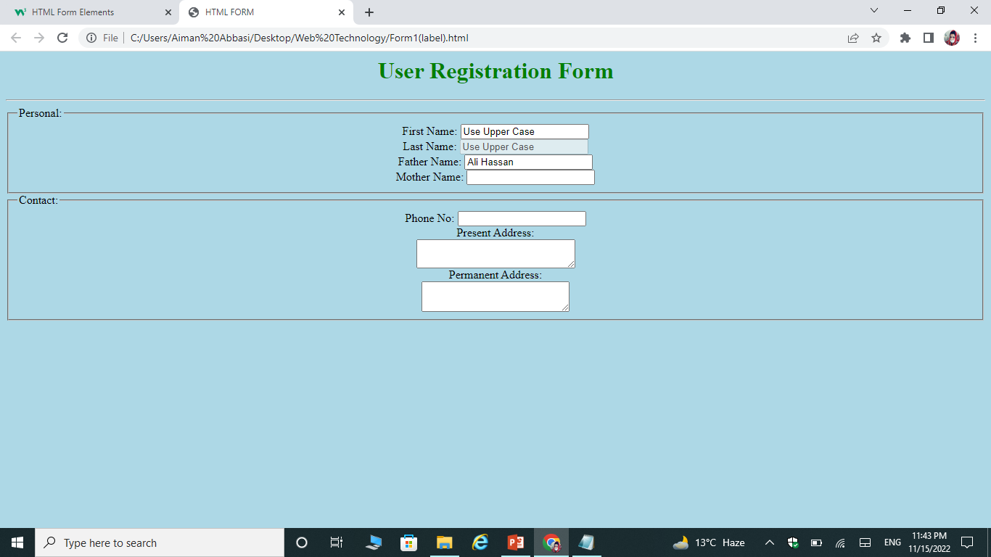
output

Slide 93
Exercise Questions

Slide 94

Exercise Questions
Create a form.

Slide 95
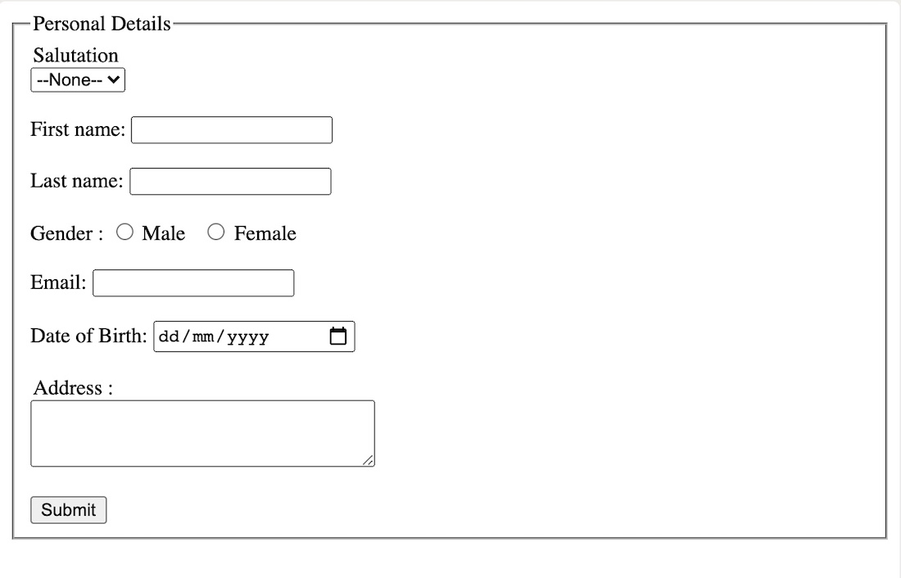
Exercise Questions
Create a form.

